Slide 1
Chapter Goals
Describe the two main responsibilities of an operating system
Define memory and process management
Explain how timesharing creates the virtual machine illusion
Explain the relationship between logical and physical addresses
Compare and contrast memory management techniques

Slide 2
Chapter Goals
Distinguish between fixed and dynamic partitions
Define and apply partition selection algorithms
Explain the stages and transitions of the process life cycle
Explain the processing of various CPU scheduling algorithms

Slide 3
Software Categories
Application software
Software written to address specific needs—to solve problems in the real world
System software
Software that manages a computer system at a fundamental level
Can you name examples of each?

Slide 4
Roles of an Operating System
Operating system
System software that
  manages computer resources, such as CPU, memory and input/output devices
  provides an interface through which a human can interact with the computer
  allows an application program to interact with these other system resources

Slide 5
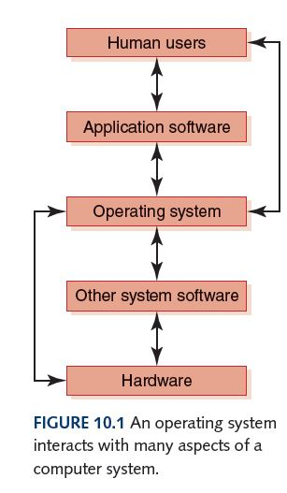
Roles of an Operating System
What operating
systems have
you used?

Slide 6
Roles of an Operating System
Booting
Hardware is wired to initially load a small set of system instructions stored in ROM
These instructions load a larger set of instructions from hard disk
Dual boot – Multiboot

Slide 7
Roles of an Operating System
The various roles of an operating system generally revolve around the idea of “sharing nicely”
An operating system manages resources, and these resources are often shared in one way or another among programs that want to use them

Slide 8
Resource Management
Multiprogramming
The technique of keeping multiple programs that compete for access to the CPU in main memory at the same time so that they can execute
Memory management
The process of keeping track of what programs are in memory and where in memory they reside

Slide 9
Resource Management
Process
A program in execution
Process management
The act of carefully tracking the progress of a process and all of its intermediate states
CPU scheduling
Determining which process in memory is executed by the CPU at any given point

Slide 10
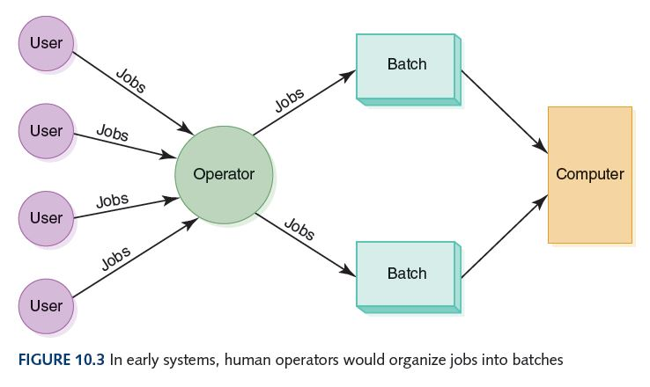
Batch Processing
The first operating system was a human operator, who organized various jobs from multiple users into batches of jobs that needed the same resources

Slide 11
Timesharing
Timesharing system
A system that allows multiple users to interact with a computer at the same time
Virtualization
Virtualization is the process of running a virtual instance of a computer system in a layer abstracted from the actual hardware. Most commonly, it refers to running operating systems being run in a virtual environment.

Slide 12
Other Factors
Real-time System
A system in which response time is crucial given the nature of the application
Response time
The time delay between receiving a stimulus and producing a response
Device driver
A small program that “knows” the way a particular device expects to receive and deliver information

Slide 13
Memory Management
Operating systems must employ techniques to
  Track where and how a program resides in memory
  Convert logical addresses into actual addresses
Logical address
Reference to a stored value relative to the program making the reference
Physical address
Actual address in main memory

Slide 14
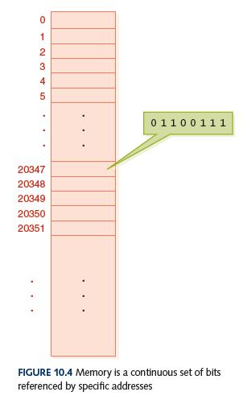
Memory Management
Program 1:
sum is assigned memory
location 23, a location
relative to Program 1
OS must map sum (relative location 23)
to a specific physical address
Logical address for sum (23) is bound to a
physical address in memory before the
program runs

Slide 15
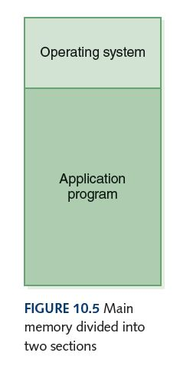
Single Contiguous MM
There are only two programs in memory
  The operating system
  The application program
This approach is called single contiguous memory management

Slide 16
Single Contiguous MM
In concrete terms:
A logical address is simply an integer value relative to the starting point of the program
A physical address is a logical address added to the starting location of the program in main memory
Advantages – Disadvantages ? - Flexibility

Slide 17
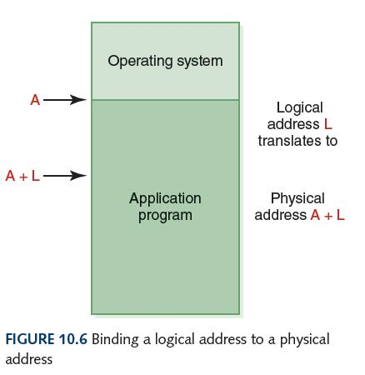
Single Contiguous MM
If A is location 100, and
the application program
is Program 1, then
sum is stored at location
123.

Slide 18
Partition Memory Management
Single contiguous MM has only the OS and one other program in memory at one time
Partition MM has the OS and any number of other programs in memory at one time
There are two schemes for dividing up memory for programs:
  Fixed partitions Main memory is divided into a fixed number of partitions into which programs can be loaded
  Dynamic partitions Partitions are created as needed to fit the programs waiting to be loaded

Slide 19
Partition Memory Management
Memory is divided into a set of partitions, some empty and some allocated to programs
Base register
A register that holds the beginning address of the current partition (the one that is running)
Limit register
A register that holds the length of the current partition

Slide 20
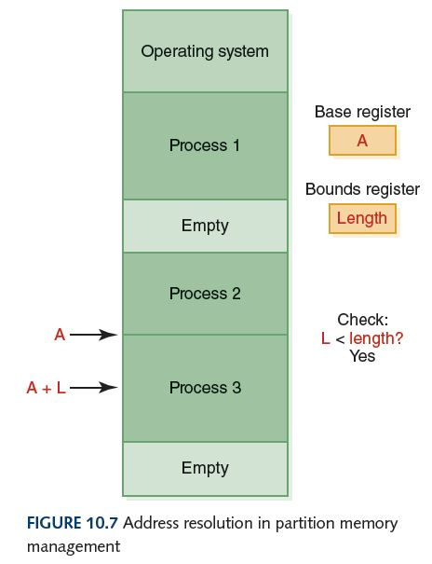
Partition Memory Management
Why check?

Slide 21
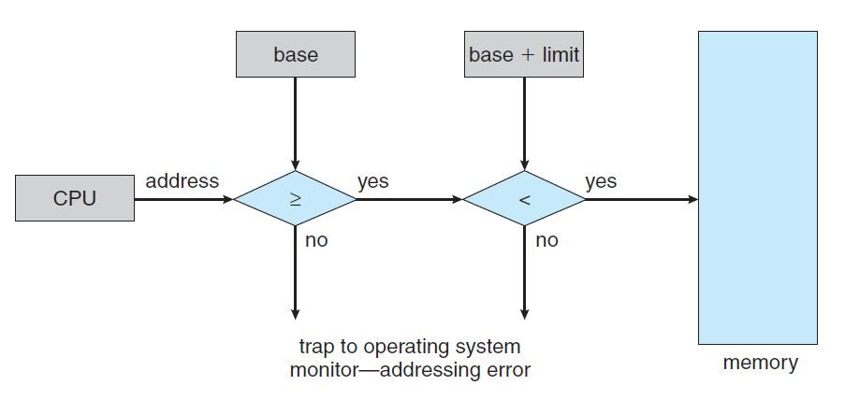

Slide 22
Partition Selection Algorithms
Which partition should we allocate to a new program?
First fit Allocate program to the first partition big enough to hold it
Best fit Allocated program to the smallest partition big enough to hold it
Worst fit Allocate program to the largest partition big enough to hold it
Can you give a rationale for each?

Slide 23
Partition Selection Algorithms
A: 1000
B: 700
C: 750
D: 1500
E: 300
F: 350
Requests come in for blocks of
the following sizes:
1000, 25, 780, 1600, and 325
What block will be assigned
to each request if the
first-fit algorithm is used?
best-fit algorithm is used?
worst-fit algorithm is used?
(Treat each request as an
independent event)

Slide 24
Process Management
Process management
The act of managing the use of the CPU by individual processes
Recall that a process is a program in execution
What stages does a process go through?

Slide 25
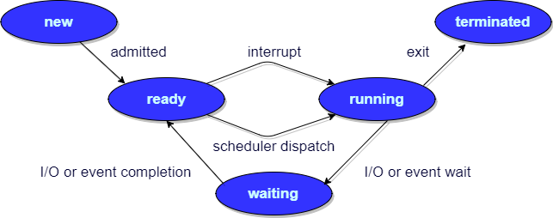
Process Management
The Process States
What can
cause a
process to
move to
the
Waiting
state?

Slide 26
Process Management
Process control block (PCB)
A data structure used by the OS to manage information about a process, including
  current value of the program counter
  values of all CPU registers for the process
  base and bound register values accounting information
Each state is represented by a list of PCBs, one for each process in that state

Slide 27
Process Management
There is only one CPU and therefore only one set of CPU registers, which contain the values for the currently
executing process
Each time a process is moved to the running state:
  Register values for the currently running process
  are stored into its PCB
  Its PCB is moved to the list of the state into which it goes
  Register values of the new process moving into the running state are loaded into the CPU
  This exchange of register information is called a context switch

Slide 28
CPU Scheduling
CPU Scheduling
The act of determining which process in the ready state should be moved to the running state
  Many processes may be in the ready state
  Only one process can be in the running state, making progress at any one time
Which one gets to move from ready to running?

Slide 29
CPU Scheduling
Nonpreemptive scheduling
The currently executing process gives up the CPU voluntarily
Preemptive scheduling
The operating system decides to favor another process, preempting the currently executing process
Turnaround time
The amount of time between when a process arrives in the ready state the first time and when it exits the running state for the last time (the total time spent between starting the process and ending the process)

Slide 30
CPU Scheduling Algorithms
First-Come, First-Served
Processes are moved to the CPU in the order in which they arrive in the running state
Shortest Job Next
Process with shortest estimated running time in the ready state is moved into the running state first
Round Robin
Each process runs for a specified time slice and moves from the running state to the ready state to await its next turn if not finished

Slide 31
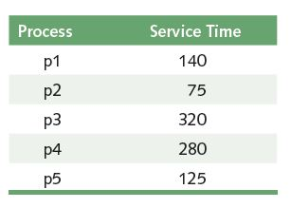
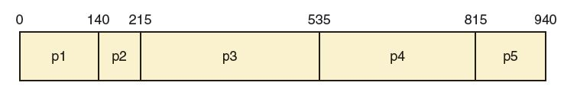
First-Come, First-Served
What is the
average turn-
around time?

Slide 32
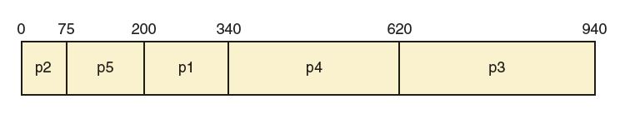
Shortest Job Next
What is the
average turn-
around time?

Slide 33
Round Robin
Every process is treated the same!
Time slice (quantum)
The amount of time each process receives before being preempted and returned to the ready state to allow another process its turn

Slide 34
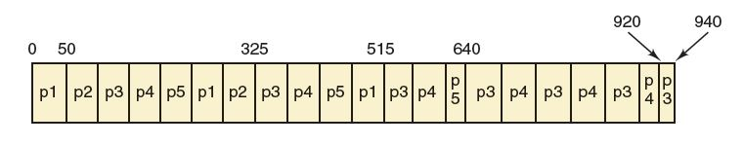
Round Robin
Suppose the time slice is 50
What is the average
turnaround time?

Slide 35
CPU Scheduling Algorithms
Are these scheduling algorithms preemptive or non-preemptive? Explain
First-Come, First-Served?
Shortest Job Next?
Round Robin?

Slide 36
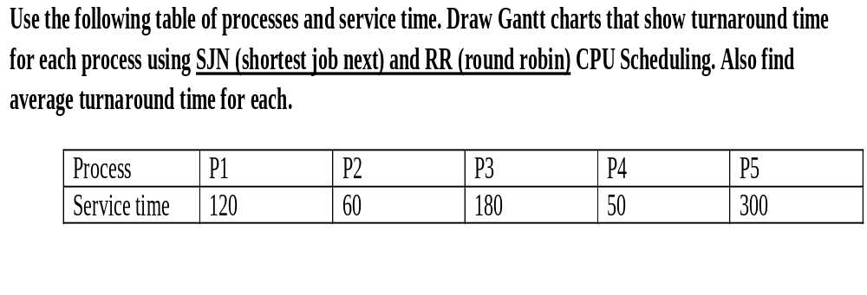

Activity 1:
302

Slide 37
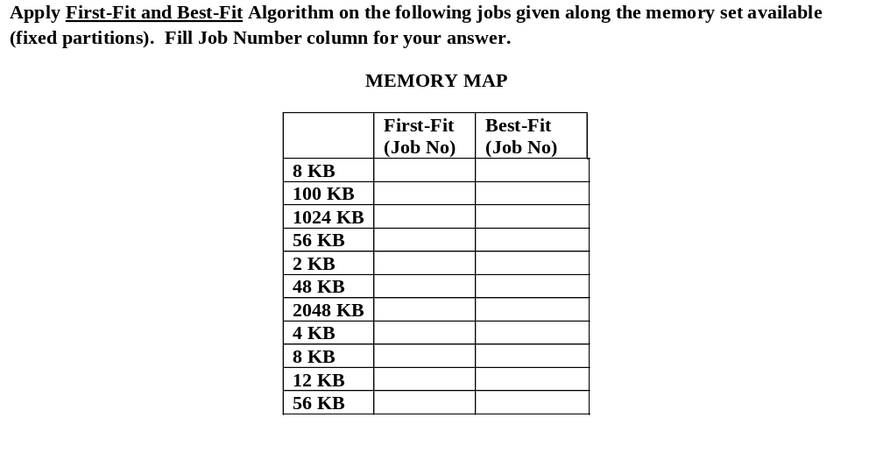
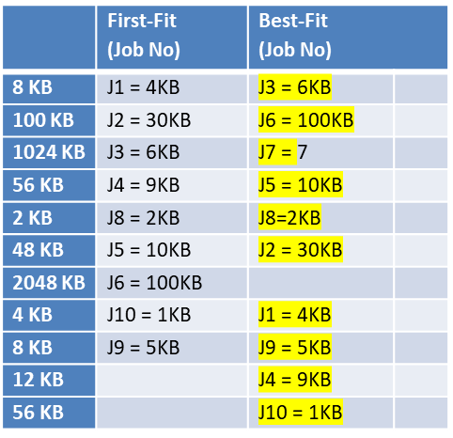
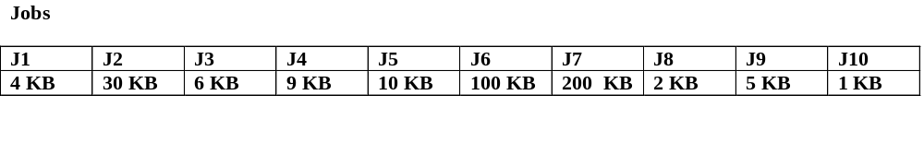
Activity 2:

Slide 38
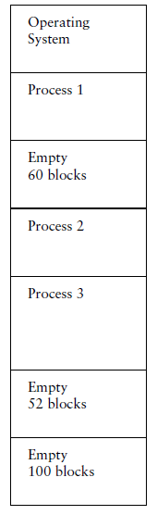
Activity 3:
If the partitions are fixed and a new job arrives
requiring 52 blocks of main memory, show memory
after using each of the following partition selection
approaches:
a. first fit (60 Block)
b. best fit (52 Blocks)
c. worst fit (100 Blocks)

Slide 39
Activity 4:
If the partitions are dynamic and a new job arrives
requiring 52 blocks of main memory, show memory
after using each of the following partition selection
approaches:
a. first fit
b. best fit
c. worst fit

Slide 40
Activity 5:
Why shouldn’t we use worst-fit partition selection in a fixed-partition memory management scheme?

